Slide 1
SOLID Principles
An object-oriented approach that are applied to software structure design

Slide 2
The word SOLID acronym for:
Single Responsibility Principle (SRP)
Open-Closed Principle (OCP)
Liskov Substitution Principle (LSP)
Interface Segregation Principle (ISP)
Dependency Inversion Principle (DIP)
It is conceptualized by Robert C. Martin (also known as Uncle Bob).

Slide 3
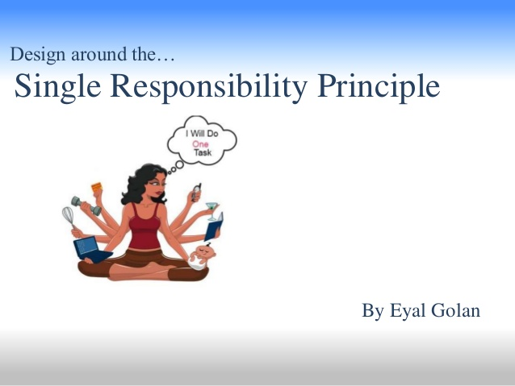

Slide 4
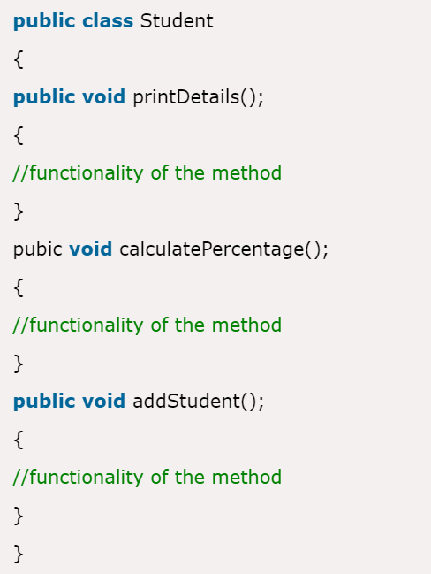
Single Responsibility Principle (SRP)
The single responsibility principle states that every class must perform a single functionality
For ex here, class Student has multiple responsibilities that may cause code mashup
Any modification effects whole class, creating difficulty in maintaining the class
Violates SRP
Notes:
As the name suggests, this principle states that each class should have one responsibility, one single purpose. This means that a class will do only one job, which leads us to conclude it should have only one reason to change.
We don’t want objects that know too much and have unrelated behavior. These classes are harder to maintain. For example, if we have a class that we change a lot, and for different reasons, then this class should be broken down into more classes, each handling a single concern. Surely, if an error occurs, it will be easier to find.
Let’s consider a class that contains code that changes the text in some way. The only job of this class should be

Slide 5
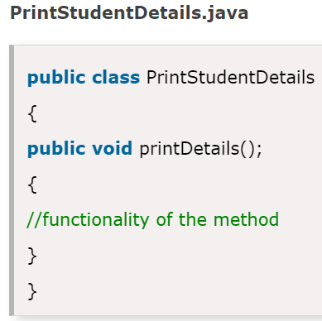
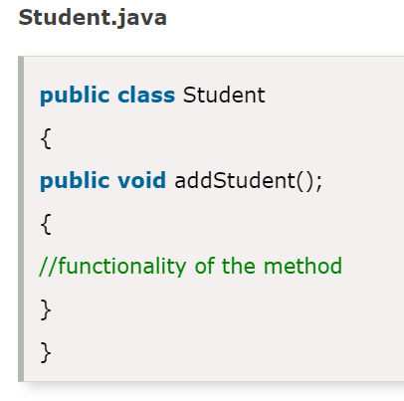
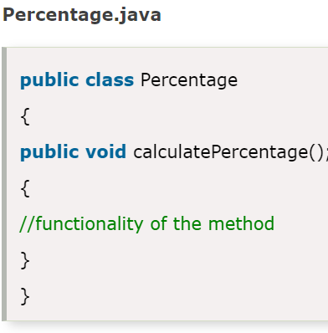
How can we obey SRP?
To achieve the goal of the principle, we should implement a separate class that performs a single functionality only.

Slide 6
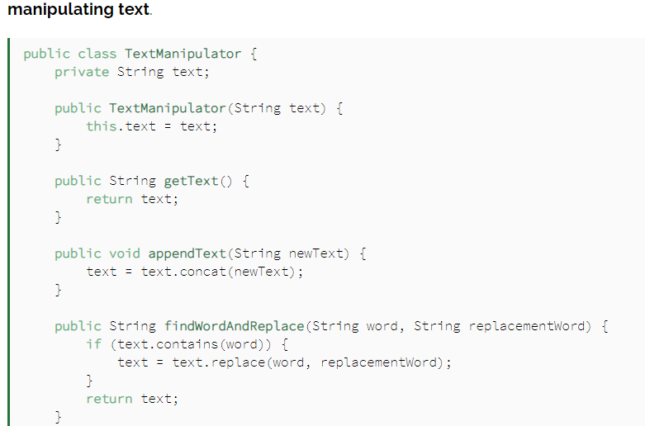
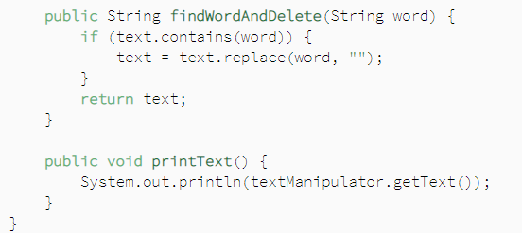
How can we obey SRP?
Lets look at one more example
Two responsibilities: manipulating and printing the text.
Notes:
Although this may seem fine, it is not a good example of the SRP. Here we have two responsibilities: manipulating and printing the text.
Having a method that prints out text in this class violate the Single Responsibility Principle. For this purpose, we should create another class, which will only handle printing text:

Slide 7
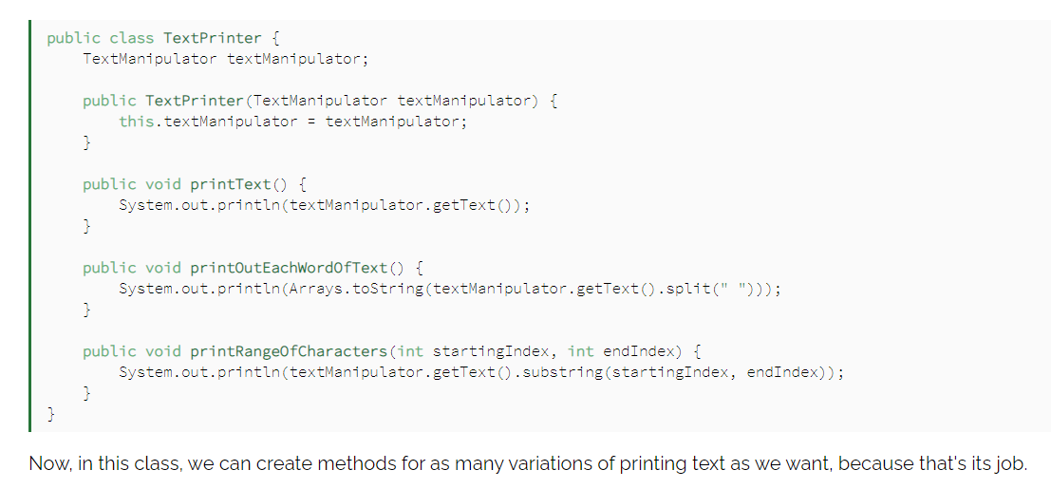
How can we obey SRP?
Lets look at one more example
Notes:
Although this may seem fine, it is not a good example of the SRP. Here we have two responsibilities: manipulating and printing the text.
Having a method that prints out text in this class violate the Single Responsibility Principle. For this purpose, we should create another class, which will only handle printing text:

Slide 8
How can the Principle be honored?
The trick of implementing SRP in our software is knowing the responsibility of each class
A right interpretation of the responsibility will help. Scope of the class needs to be clarified.
We must think about the problem domain, business needs, and application architecture
Notes:
The trick of implementing SRP in our software is knowing the responsibility of each class.
However, every developer has their vision of the class purpose, which makes things tricky. Since we don’t have strict instructions on how to implement this principle, we are left with our interpretations of what the responsibility will be.
What this means is that sometimes only we, as designers of our application, can decide if something is in the scope of a class or not.
When writing a class according to the SRP principle, we have to think about the problem domain, business needs, and application architecture. It is very subjective, which makes implementing this principle harder then it seems. It will not be as simple as the example we have in this tutorial.
This leads us to the next point.

Slide 9
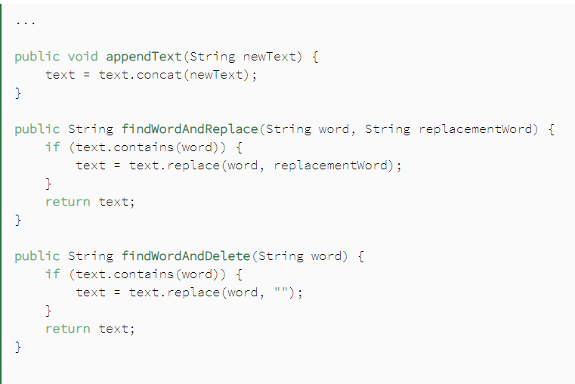
Cohesion
TextManipulator class methods
Here, we have a clear representation of what this class does
Notes:
Following the SRP principle, our classes will adhere to one functionality. Their methods and data will be concerned with one clear purpose. This means high cohesion, as well as robustness, which together reduce errors.
When designing software based on the SRP principle, cohesion is essential, since it helps us to find single responsibilities for our classes. This concept also helps us find classes that have more than one responsibility

Slide 10
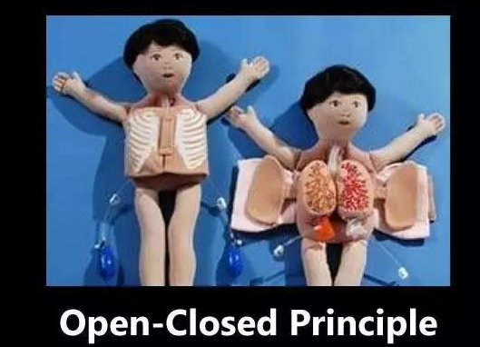

Slide 11
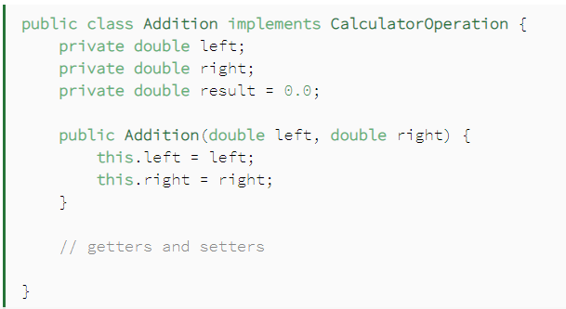
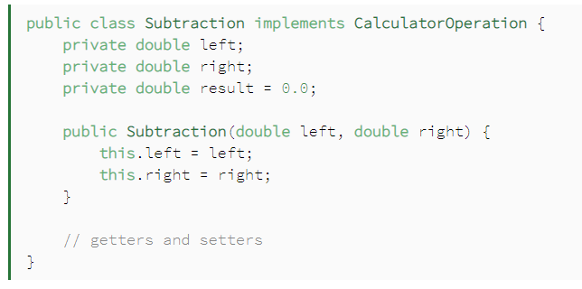

Open-Closed Principle (OCP)
The open-closed principle states that according to new requirements the module/application should be open for extension but closed for modification.
The extension allows us to implement new functionality to the module
For ex- A calculator has lot of operations to do. So, we will define a top level interface called calculator_operation()
Let's define 2 classes Addition and subtraction class, which would add two numbers and implement the CalcullatorOperation:

Slide 12
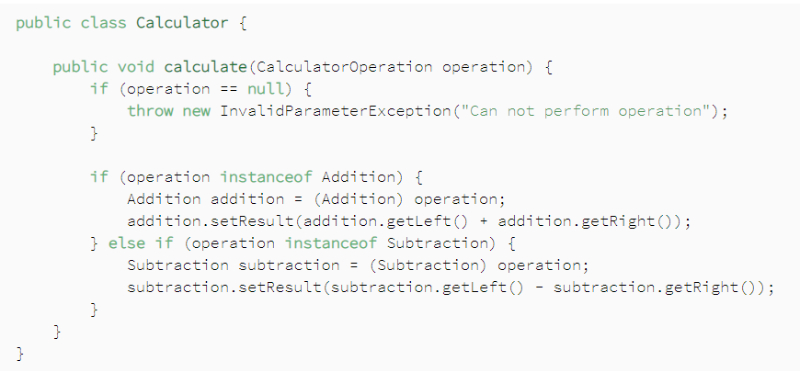
Let's now define our main class, which will perform our calculator operations:
When a new requirement of adding multiplication or divide functionality comes in, we've no way besides changing the calculate method of the Calculator class.

Slide 13
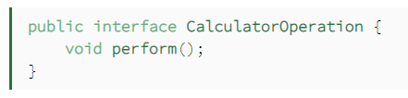
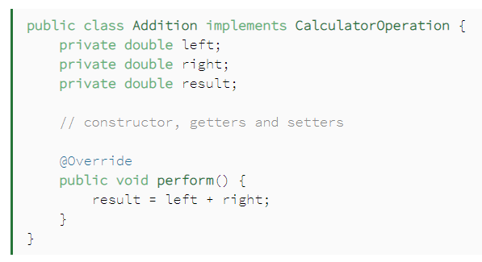
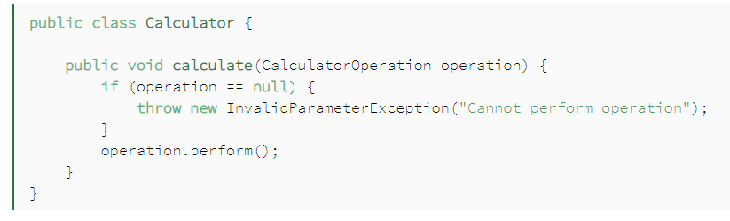
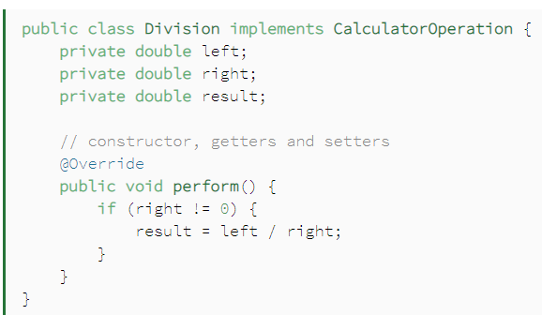
So, we need to extract this code and put it in an abstraction layer. One solution is to delegate each operation into their respective class:
Likewise, an updated Subtraction class would have similar logic.
As a new change request, we could implement the division logic
And finally, our Calculator class doesn't need to implement new logic as we introduce new operators.

Slide 14


Slide 15
Liskov Substitution Principal as defined by Barbara Liskov & Jeannette Wing.
She first presented her idea through a paper in 1986. Then presented it as a topic in a conference.
As the name suggests, Liskov Substitution Principle prescribes substitutability of a class by its subclass.
Broadly put, a class can be replaced by its subclass in all practical usage scenarios.
This is in line with what Java also allows. A superclass reference can hold a subclass object i.e. superclass can be replaced by subclass in a superclass reference at any time.
So, Java inheritance mechanism follows Liskov Substitution Principle.

Slide 16
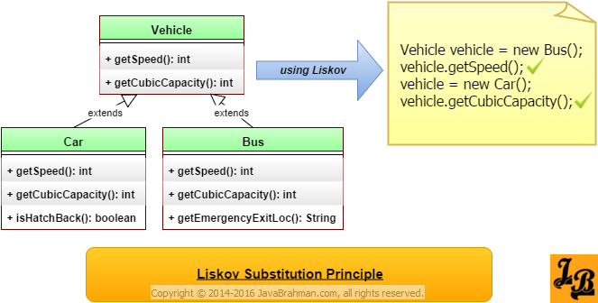
Let's take an example
Let's say we have a class Vehicle and its two sub-classes Car & Bus as shown:
Functionalities acquired by Bus and Car can be invoked on a reference of type Vehicle
It is possible to invoke methods like getSpeed() & getCubicCapacity() on a Vehicle reference which holds a Bus/Car object.
Notes:
Now, we can assign an object of type Car or that of type Bus to a reference of type Vehicle.
All the functionality which is inherent in base class Vehicle, and is acquired by Bus and Car via inheritance, can be invoked on a reference of type Vehicle
Referring to the diagram above, it is possible to invoke methods like getSpeed() & getCubicCapacity() on a Vehicle reference which actually holds a Bus/Car object.
The actual object’s overridden implementation of these methods will be actually invoked. This is exactly what the Liskov Substitution Principle also states – subtype objects can replace super type objects without affecting the functionality inherent in the super type.

Slide 17
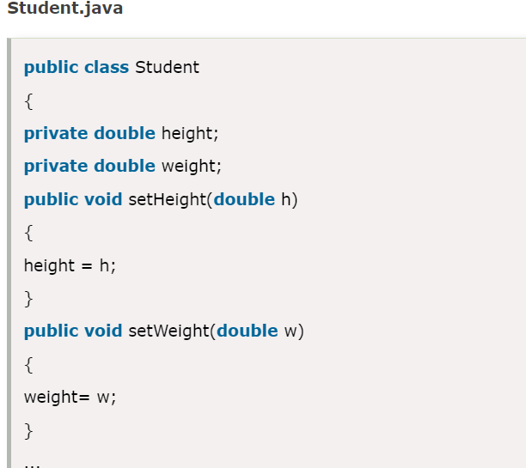
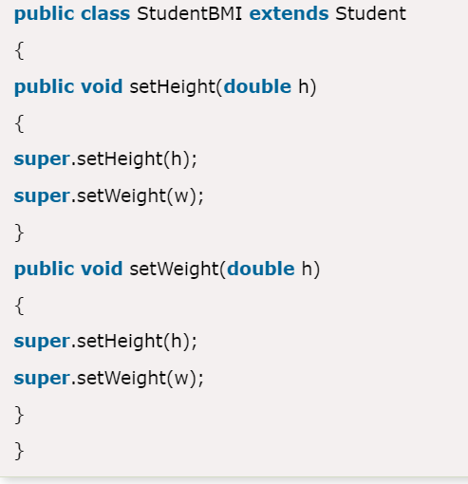
A Violation example:
StudentBMI class has extra constraints i.e. height and weight that must be the same. Therefore, the Student class (base class) cannot be replaced by StudentBMI class (derived class).
Notes:
Now, we can assign an object of type Car or that of type Bus to a reference of type Vehicle.
All the functionality which is inherent in base class Vehicle, and is acquired by Bus and Car via inheritance, can be invoked on a reference of type Vehicle
Referring to the diagram above, it is possible to invoke methods like getSpeed() & getCubicCapacity() on a Vehicle reference which actually holds a Bus/Car object.
The actual object’s overridden implementation of these methods will be actually invoked. This is exactly what the Liskov Substitution Principle also states – subtype objects can replace super type objects without affecting the functionality inherent in the super type.

Slide 18
The Circle-Ellipse Problem.
Eclipse (Super class) | Circle (inherited class)
double lenghtofxAxis | double lenghtofxAxis
double lenghtofYAxis | double lenghtofYAxis
setLengthOfAxisX() | setLengthOfAxisX()
setLengthOfAxisY() | setLengthOfAxisY()
In this case an object of type Circle can be assigned to a reference of type Ellipse.
One inherent functionality of an ellipse is that its stretchable. I.e. the length of the two axes of an ellipse can be changed.
Lets say we have methods setLengthOfAxisX() and setLengthOfAxisY() through which the length of the two axes X & Y of an ellipse can altered
However, calling any of these two methods on an object of type circle inside a reference of type ellipse would lead to a circle no longer being a circle as in a circle the length of the major and minor axes have to be equal.
Notes:
All circles are inherently ellipses with their major and minor axes being equal. In terms of classes if we make a class Ellipse then Circle class will be a child of Ellipse class i.e. it will extend Ellipse class. Nothing wrong in it so far.
Lets now use the Liskov Substitution Principle. In this case an object of type Circle can be assigned to a reference of type Ellipse. So, all the methods in Ellipse can/could be invoked on this object of Circle which is stored in it. One inherent functionality of an ellipse is that its stretchable. I.e. the length of the two axes of an ellipse can be changed. Lets say we have methods setLengthOfAxisX() and setLengthOfAxisY() through which the length of the two axes X & Y of an ellipse can altered.
However, calling any of these two methods on an object of type circle inside a reference of type ellipse would lead to a circle no longer being a circle as in a circle the length of the major and minor axes have to be equal. This is known as the Circle-Ellipse Problem.

Slide 19
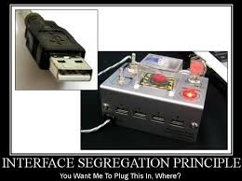

Slide 20
This principle was first defined by Robert C. Martin as: “Clients should not be forced to depend upon interfaces that they do not use“.
The goal of this principle is to reduce the side effects of using larger interfaces by breaking application interfaces into smaller ones
It's like the Single Responsibility Principle, where each class or interface serves a single purpose.
Notes:
Precise application design and correct abstraction is the key behind the Interface Segregation Principle. Though it'll take more time and effort in the design phase of an application and might increase the code complexity, in the end, we get a flexible code.
We'll look into some examples in the later sections where we have a violation of the principle, and then we'll fix the problem by applying the principle correct

Slide 21
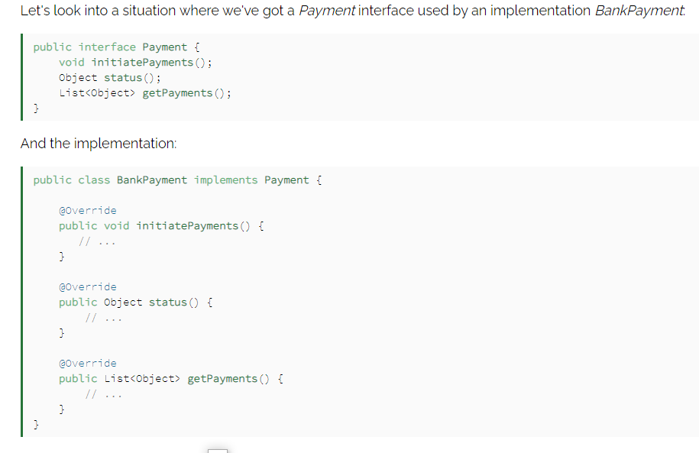
The implementing class BankPayment needs all the methods in the Payment interface. Thus, it doesn't violate the principle.
Notes:
Now, we can assign an object of type Car or that of type Bus to a reference of type Vehicle.
All the functionality which is inherent in base class Vehicle, and is acquired by Bus and Car via inheritance, can be invoked on a reference of type Vehicle
Referring to the diagram above, it is possible to invoke methods like getSpeed() & getCubicCapacity() on a Vehicle reference which actually holds a Bus/Car object.
The actual object’s overridden implementation of these methods will be actually invoked. This is exactly what the Liskov Substitution Principle also states – subtype objects can replace super type objects without affecting the functionality inherent in the super type.

Slide 22
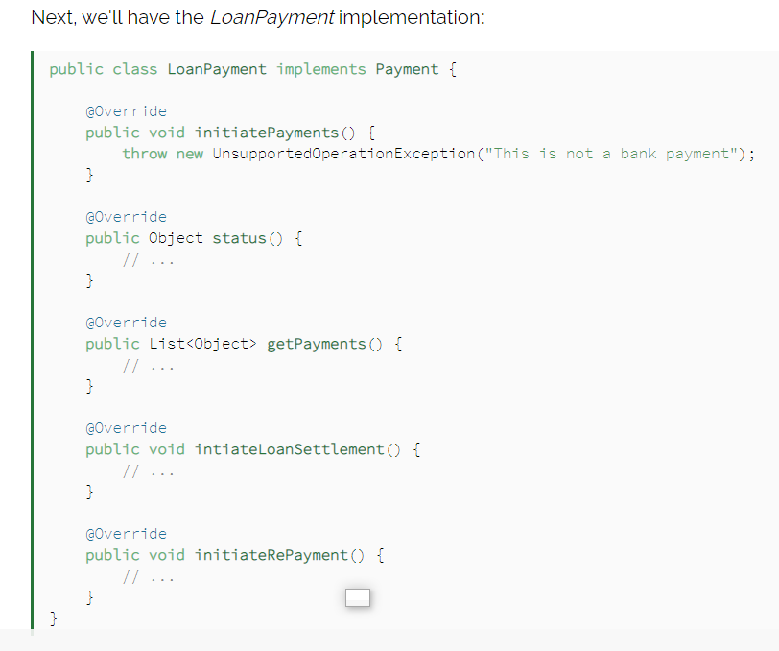
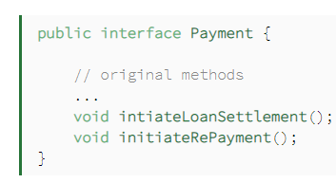
Now, as we move ahead in time, and more features come in, there's a need to add a LoanPayment service. This service is also a kind of Payment but has a few more operations.
To develop this new feature, we'll add the new methods to the Payment interface
Notes:
Now, since the Payment interface has changed and more methods were added, all the implementing classes now have to implement the new method.
The problem is, implementing them is unwanted and could lead to many side effects. Here, the LoanPayment implementation class has to implement the initiatePayments() without any actual need for this. And so, the principle is violated

Slide 23
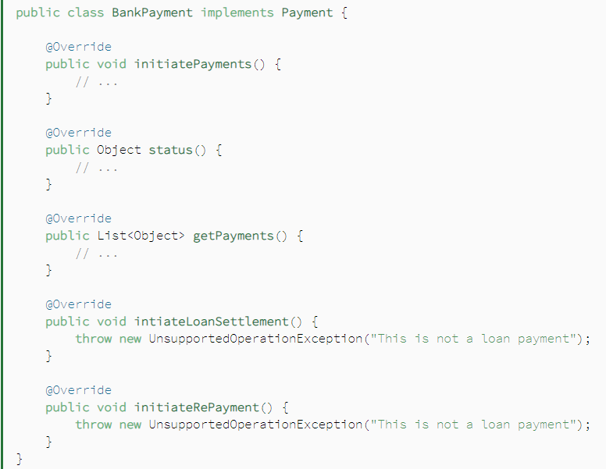
So what will happen to our Bankpayment class
BankPayment implementation now has implemented the new methods. And since it does not need them and has no logic for them, it's just throwing an UnsupportedOperationException.
This is where we start violating the principle.

Slide 24
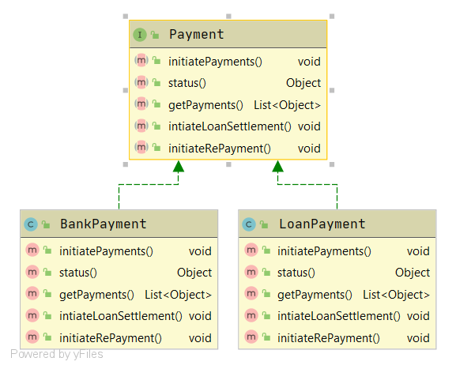
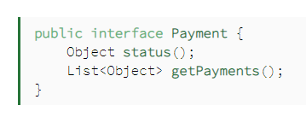
Applying the Principle
Let's break up the interfaces and apply the Interface Segregation Principle.
Notes:
Notice in the class diagram, and referring to the interfaces in the earlier section, that the status() and getPayments() methods are required in both the implementations. On the other hand, initiatePayments() is only required in BankPayment, and the initiateLoanSettlement() and initiateRePayment() methods are only for the LoanPayment.

Slide 25
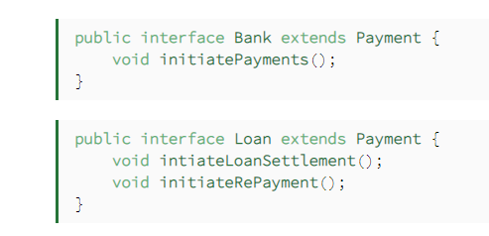
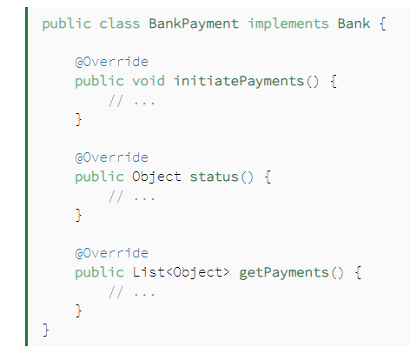
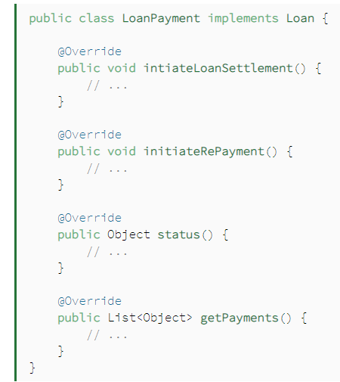
And two more interfaces for the two types of payments:
And the respective implementations, starting with BankPayment:
And finally, our revised LoanPayment implementation:

Slide 26
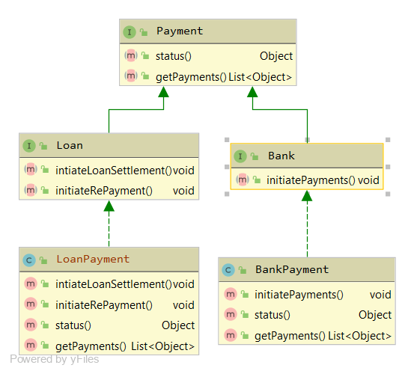
Now, let's review the new class diagram:
The implementations don't have to provide empty methods. This keeps the code clean and reduces the chance of bugs.

Slide 27


Slide 28
The general idea of this principle is as simple as it is important: High-level modules, which provide complex logic, should be easily reusable and unaffected by changes in low-level modules, which provide utility features.
To achieve that, you need to introduce an abstraction that decouples the high-level and low-level modules from each other.
Based on this idea, Robert C. Martin’s definition of the Dependency Inversion Principle consists of two parts:
High-level modules should not depend on low-level modules. Both should depend on abstractions.
Abstractions should not depend on details. Details should depend on abstractions.

Slide 29
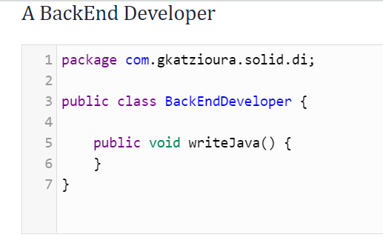
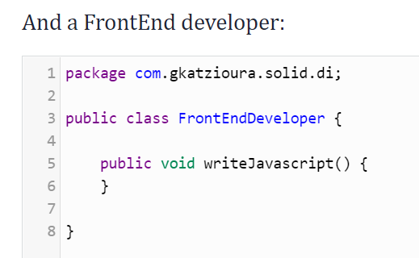
Let’s get started with some code that violates that principle.
Say you are working as part of a software team. We need to implement a project. For now, the software team consists of

Slide 30
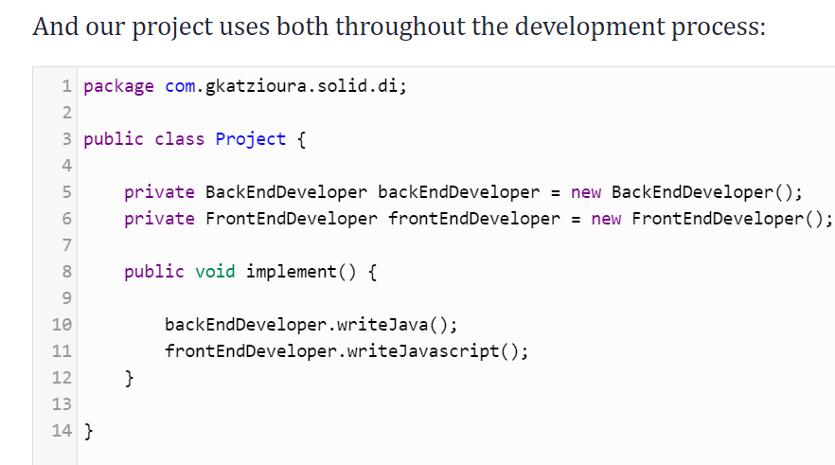
Project class is a high-level module, and it depends on low-level modules such as BackEndDeveloper and FrontEndDeveloper. We are actually violating the first part of the dependency inversion principle
Inspecting the implement function of Project.class, we realize that the methods writeJava and writeJavascript are methods bound to the corresponding classes.
Notes:
Regarding the project scope, those are details since, in both cases, they are forms of development. Thus, the second part of the dependency inversion principle is violated.

Slide 31
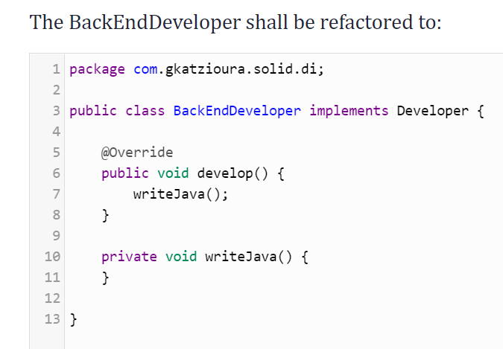
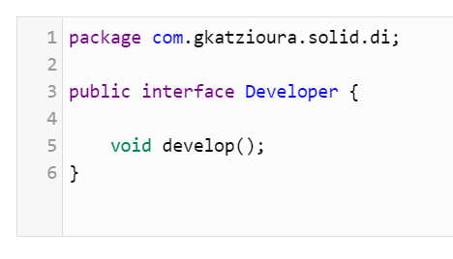
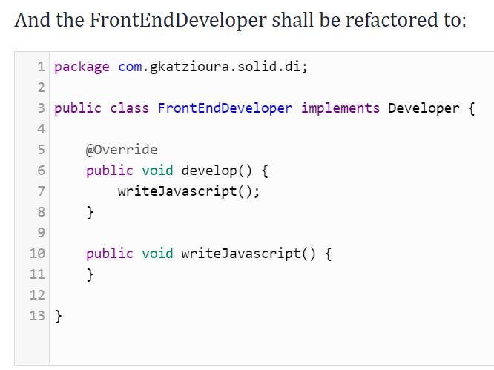
How do we tackle this?

Slide 32
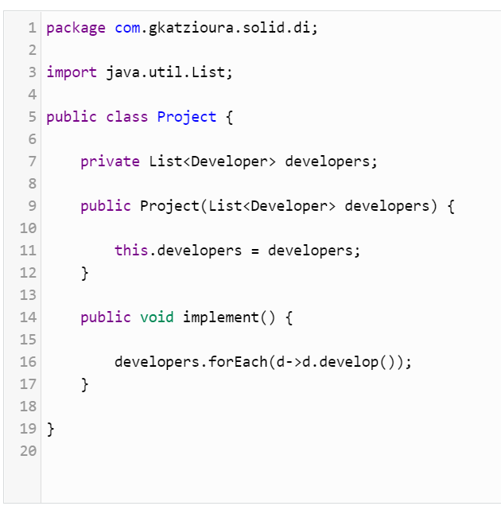
The next step, in order to tackle the violation of the first part, would be to refactor the Project class so that it will not depend on the FrontEndDeveloper and the BackendDeveloper classes.
Notes:
The outcome is that the Project class does not depend on lower level modules, but rather abstractions. Also, low-level modules and their details depend on abstractions.

Slide 33
Thanks Guys , that’s all I had to discuss

